Slide 1
JavaScript

Slide 2
Agenda
What is JavaScript?
JavaScript core
Syntax, variables, values, and data types
Differences between let and var
Control Structure:
Control flow and conditional statements
Loops and iterations
Jumps
Error Handling
Objects and related methods
JSON
Regular expressions
Objects
ES6 Features
Browser Object Model
Document Object Model
Handling Events
JavaScript Async: JavaScript Callback, Promises, Sync/Await

Slide 3
What is JavaScript?
JS is an OO Scripting Language
Light weighted & Interpreted:
JS Case-sensitive:
Supports all types of OS
All the browsers has Direct support
Weakly typed language

Slide 4
History
In 1993, Mosaic
In the year 1994, Netscape was founded by Marc Andreessen.
Websites need to be more dynamic.
glue language
In 1995, the company recruited Brendan Eich
But, before Brendan could start, the company merged with Sun Microsystems
Now, two languages were there: Java and the scripting language.
In May 1995, Brendan Eich invented first code of Javascript named 'Mocha’
Renamed with 'LiveScript’
Due to trademark reasons and certain other reasons, in December 1995, the language was finally renamed to 'JavaScript'

Slide 5
Features of JavaScript
Make our website alive:
Script Can execute on the browser:
JS and Java are completely different:
JS: All scripting languages are ultimately translated into JS:
All the browsers: built-in execution environments
supportable in several operating systems including
Similar to the Syntax of C programming:
Weakly typed language:

Slide 6
Applications of JavaScript:
Client-side validation
Dynamic drop-down menus
Displaying date and time
Displaying pop-up windows and dialog boxes (like an alert dialog box, confirm dialog box, and prompt dialog box)
Displaying clocks etc.

Slide 7
Syntax:
<body>
<script>
alert("JavaScript");
</script>
</body>

Slide 8
JavaScript code syntax:
Within body tag
Within head tag
External JavaScript file

Slide 9
Advantages of External JavaScript
Reusability of code
It allows easy code readability
It is time-efficient as web browsers cache the external js files, which further reduces the page loading time.
It enables both web designers and coders to work with html and js files parallelly and separately
The length of the code reduces as only we need to specify the location of the js file

Slide 10
Disadvantages of External JavaScript
The stealer may download the coder's code using the URL of the js file
If two JS files are dependent on one another, then a failure in one file may affect the execution of the other dependent file
The web browser needs to make an additional HTTP request to get the JS code
A small to a large change in the JS code may cause unexpected results in all its dependent files

Slide 11
JavaScript Comment
Single-line Comment
Multi-line Comment

Slide 12
Identifiers in JavaScript
Identifiers are JavaScript names
Identifiers are used to name variables, constants, and functions
The rules for legal names are the same in most programming languages
A JavaScript name must begin with:
A letter (A-Z or a-z)
A dollar sign ($)
Or an underscore (_)
Numbers are not allowed as the first character in names

Slide 13
Variables in JavaScript:
What is a variable?
JavaScript uses the keywords var, let and const to declare variables
The var keyword was used in all JavaScript code from 1995 to 2015
The let and const keywords were added to JavaScript in 2015
The var keyword should only be used in code written for older browsers
Example: var a=100;
let a=100;

Slide 14
Differences between let and var keyword
var | let
The scope of a var variable is the functional or global scope. | The scope of a let variable is block scope.
It can be updated and re-declared in the same scope. | It can be updated but cannot be re-declared in the same scope.
It can be declared without initialization. | It can be declared without initialization.
It can be accessed without initialization as its default value is “undefined”. | It cannot be accessed without initialization otherwise it will give ‘referenceError’.
Hoisting is allowed with the help of var keyword | Hoisting is not allowed with let keyword

Slide 15
Types of variables in JavaScript:
Local Variable
Global Variable

Slide 16
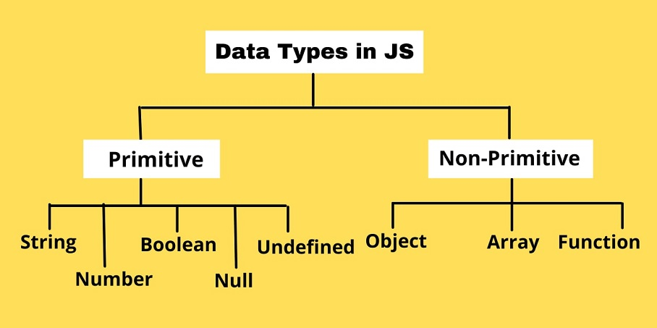
Data types in JavaScript:
Primitive data types
Non primitive

Slide 17
Primitive Data types:
Null type: The Null type is inhabited by exactly one value: null:
It is an Explicit Data type
Undefined type: The Undefined type is inhabited by exactly one value: undefined:
It is Implicit Data type
undefined indicates the absence of a value
Boolean type: The Boolean type represents a logical entity and is inhabited by two values: true and false.
Number: The Number type is a double-precision 64-bit data type
It is capable of storing positive floating-point numbers between 2⁻¹⁰⁷⁴ and 2¹⁰²⁴
Negative floating-point numbers between -2⁻¹⁰⁷⁴ and -2¹⁰²⁴
It can only safely store integers in the range -(2⁵³ − 1) to 2⁵³ − 1
String: The String type represents textual data and is encoded as a sequence of 16-bit unsigned integer values

Slide 18
Significance about Primitive Data types:
When a primitive data type is defined, it is given an address on the Call Stack, rather than the Memory Heap
Immutable:
A primitive data type cannot be changed after its creation, meaning that it is an immutable data type
If we assign a primitive data type a new value, the prior value’s address is still held in memory, and the new value is given a different address
Fixed Size
Primitive data types can only be one size. They cannot grow or shrink in size. They only hold a single value.
Simple Data Type
Primitive data types cannot be broken down into smaller data types
Methods:

Slide 19
Non-Primitive Data types:
Derived from the primitive data types and are also known as reference data types or derived data types
These data types are stored in the heap memory of the system, unlike primitive data types which are stored in the stack space of the system

Slide 20
1. Array
JavaScript arrays are written with square brackets
Array items are separated by commas
An array is a special variable, which can hold more than one value
EX: const names = [“Nilesh", “Vinod", “Shashi"];
Creating Array in Java:
By array literal: var arrayname=[value1,value2.....valueN];
By creating an instance of Array directly: var arrayname=new Array();
By using an Array constructor: var names=new Array("Jai", "Vijay",“Ajay");

Slide 21
2. Objects
JavaScript objects are written with curly braces {}
Objects are variables too. But objects can contain many values
Object properties are written as name: value pairs, separated by commas
EX: const person = {firstName: “Nilesh ", lastName: “MAgar", age:40, eyeColor:"black"};
You can access object properties in two ways:
objectName.propertyName: person.firstname
OR
objectName["propertyName"]: person[“firstname”]

Slide 22
2. Objects
How to Define a JavaScript Object
Using an Object Literal: const person = {firstName:“Ajay", lastName:“Patil", age:30, height:171};
Using the new Keyword: const person = new Object();
Using an Object Constructor:
function person(firstName, lastName, age){
this. firstName = firstName;
this. lastName = lastName;
this. age = age;
}
obj=new person(“Ajay”, “Patil”, 30);

Slide 23
2. Objects
Objects are containers for Properties and Methods
Properties are named Values
Methods are Functions stored as Properties
In JavaScript, almost "everything" is an object
Objects, Maths, Functions, Dates, Arrays, Maps, Sets are objects
Objects are mutable: They are addressed by reference, not by value
const x = person;
Object x is not a copy of person
The object x is person
The object x and the object person share the same memory address
Any changes to x will also change person:
You can add new properties to an existing object
The delete keyword deletes a property from an object
Property values in an object can be other objects
myObj = { name:"John",
age:30,
myCars: {
car1:"Ford",
car2:"BMW",
car3:"Fiat" }}

Slide 24
Array Vs Object
Arrays
Object
An array is a collection of data stored in a sequence of memory locations
It can store various data types, including integers, floats, strings, and booleans
Array elements can be accessed using index numbers, starting from 0.
Arrays are mutable, meaning you can add, remove, and modify elements in an array
Arrays have built-in methods and properties that allow for easy manipulation and iteration, such as push(), pop(), length, and forEach()
An object is a mutable data structure used to represent a thing or entity.
It stores data in key-value pairs, where the keys can be any string or symbol except for undefined

Slide 25
3. Functions in JavaScript
JS functions are very similar to the functions in C programming, except return type
It is a block of code designed to perform a particular task
function is executed only when we call it
Syntax:
function name(parameter1, parameter2, parameter3) {
// code to be executed
}
parameters(local variables), arguments
Function expressions: anonymous
Function hoisting:
const square = function (number) {
return number * number;};
console.log(square(4));
const factorial = function fac(n) {
return n < 2 ? 1 : n * fac(n - 1);};
console.log(factorial(3));

Slide 26
Operators in JavaScript
Arithmetic Operators: +, - , * , / , % , ++ , --
Comparison (Relational) Operators: ==, ===, !=, !==, >, >=, <, <=
Bitwise Operators: &, |, ^, ~, <<, >>
Logical Operators: &&, ||, !
Assignment Operators: =, +=, -=, *=, /=, %=
Special Operators: (?:) , , delete, in , new, typeof

Slide 27
If-else
If Statement
If else statement
if else if statement

Slide 28
switch statement
switch(expression){
case value1:
code to be executed;
break;
case value2:
code to be executed;
break;
......
default:
code to be executed if above values are not matched;
}

Slide 29
Loops
for loop
while loop
do-while loop
for-in loop

Slide 30
Arrow function in JavaScript
Arrow functions are introduced in ES6
Also called as, Lambda expression
Arrow functions allow us to write shorter function syntax:
JS uses FAT arrow:
Anonymous function:
const myFunction = function (a, b) { document.write(a * b); }
myFunction(10, 2);
Arrow function:
const myFunction = (a, b) => { document.write(a * b); }
myFunction(10, 2);

Slide 31
Arrow function with return statement
hello = () => { let a;
Let b=100;
return "Hello World!";
}
If the function has only one statement, and the statement returns a value, you can remove the brackets and the return keyword
hello = () => "Hello World!";

Slide 32
Arrow Function without Parentheses
If you have a single parameter to pass, then the parentheses are optional
var square = x => {
document.write(x*x);
}
square(2);

Slide 33
Optional Parameters
By using logical operator:
The optional parameter is Logically OR is used with the default value within the body of the function
The optional parameters should always come at the end of the parameter list
function check(a, b) {
b = b || 0;
console.log("Value of a is: " + a +
" Value of b is: " + b);
}
check(5, 3);
check(10);

Slide 34
Default Parameters
Default parameter is a value that will always be available
When no value is passed in the function definition, a default value is being set for the function definition, known as the default parameter
It allows the named parameters to get initialized with a default value when either undefined or no value is passed
function sum(a=5, b=7)
{
return a+b;
}
sum();
sum(10);
sum(10,10)

Slide 35
Rest Parameters
It is introduced in ECMAScript 2015 or ES6
It allows us to represent an indefinite number of arguments as an array
By using the rest parameter, a function can be called with any number of arguments
A rest parameter must be last in a parameter list
function show(...args)
{
let sum = 0;
for (let i of args) {
sum += i;
}
console.log("Sum = "+sum);
}
show(10, 20, 30);

